Slide 1


JOINT MODELING OF SURVIVAL AND TUMOR SIZE IN NSCLC
CLINICAL TRIAL SIMULATIONS AND MODEL VALIDATION AT STUDY AND SUBJECT LEVELS
Dmitry Onishchenko, James Dunyak, Gabriel Helmlinger,
Kirill Peskov Eric Masson, Helen Tomkinson,
Nidal Al-Huniti
M&S Decisions, Moscow, Russia Quantitative Clinical Pharmacology, AstraZeneca, Waltham, MA, USA

Slide 2
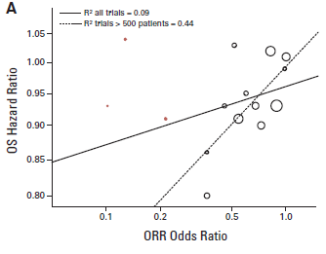
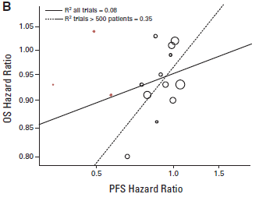
Motivation
Surrogate endpoints in oncology and their relation to survival
TYPICAL DATA OBTAINED IN VARIOUS PHASES
OF CANCER DRUG DEVELOPMENT
PRECLINICAL | PHASE I, II | PHASE III
► Tumor Growth Inhibition (TGI) | ► Tumor Size Dynamics ► Objective Response Rate (ORR) ► Early PFS | ► Progression-Free Survival (PFS) ► Overall Survival (OS)
…….. R² trials > 500 patients = 0.44
______ R² all trials = 0.09
…….. R² trials > 500 patients = 0.35
OS Hazard Ratio
______ R² all trials = 0.08
Weak correlations between
{OS, ORR} and {OS, PFS}
in an analysis of 14 Ph. III NSCLC studies
OS Hazard Ratio
Blumenthal et al J Clin Oncol 2015
ORR Odds Ratio
Critical amount of information is lost when categorizing tumor size dynamics into RECIST, and then ORR
PFS Hazard Ratio

Slide 3
RECIST: Patient response is reduced to a single value
RECIST⁽¹⁾ data
Time (months) | 0 | 2 | 5 | 7 | 10
Target Lesion SLD⁽²⁾ (cm)
Nontarget Lesion |  | SD | SD | SD | SD
New Lesion |  | No | No | No | Yes
Response |  | PR | PR | PR | PD
Reduction to Single Values:
Time to Progression | 10 mo.
Best Overall Response | PR
Best Percent Change in SLD | 55%
6 cm
4 cm
2 cm
1. RECIST = Response Evaluation Criteria In Solid Tumors SD = Stable Disease
2. SLD = Sum of Longest Diameters of target lesions PR = Partial Response
PD = Progressive Disease
Slide courtesy: adapted from Andy Stein

Slide 4
Continuous modeling of endpoints: Sequential approach
Longitudinal model provides covariates to event model
Tumor Size Modeling
Longitudinal covariates, Exponential decay rate, Response at 8 weeks, etc
Event Modeling
Cox Proportional Hazard
Fractional tumor size
Survival
[Days]
Tumor Size
Treatment Arm
ECOG
Performance
Status
~
+
+
Days after treatment start
~
a₁*TS
a₂*ARM
Survival Hazard
a₃* ECOG
{a₁, a₂, a₃} are Cox coefficients specifying a link between patient measurements and survival
Implementation:
FDA Wang et al Clin Pharmacol Ther 2009
Industry (Roche) Claret et al J Clin Oncol 2013
(Pfizer) Schindler et al CPT PSP 2016

Slide 5

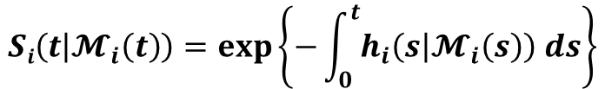
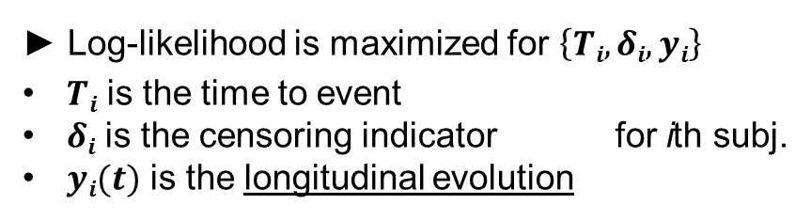



Continuous modeling of endpoints: Joint approach
►Individual survival function:
$$Si(t)$$
$$Si\left(t | 𝓜_{i}\left(t\right)\right)=\exp\left\{−\int_{0}^{t}{h_{i}\left(s | 𝓜_{i}\left(s\right)\right) ds}\right\}$$
Survival
► Log-likelihood is maximized for $\left\{Ti, δi, yi\right\}$
$Ti$ is the time to event
$δi$ is the censoring indicator for ith subj.
$yi(t)$ is the longitudinal evolution
Time after treatment initiation
$$hi(t)$$
Hazard (relative risk)
Time after treatment initiation
measured with error!
$$𝓜_{i}\left(t\right)$$
► Maximization is conditional on baseline covariates
Relative tumor size
$$yi(t)$$
Ibrahim 2010, J Clin Oncol 28:2796-2801
Rizopoulos 2010, J Stat Soft 35:1-33
Time after treatment initiation

Slide 6
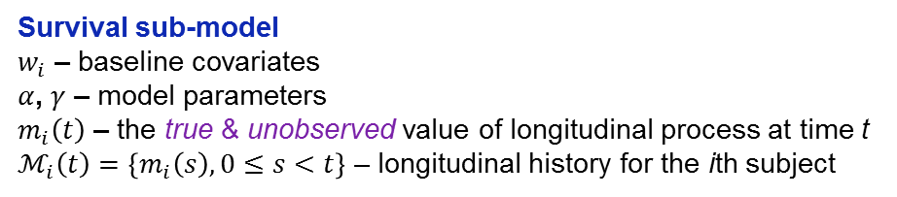
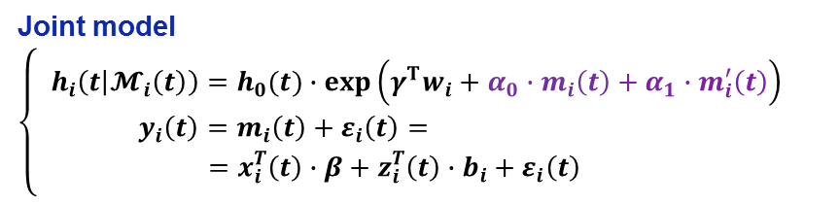


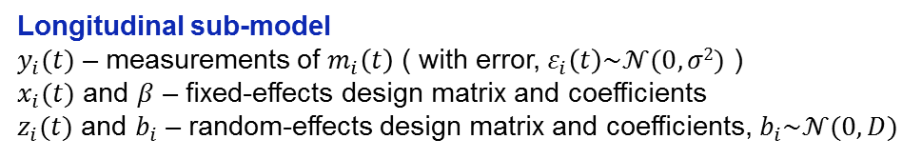
Joint model of survival and patient response
Time-dependent slopes
Joint model
$$\left\{\begin{aligned}h_{i}\left(t | 𝓜_{i}\left(t\right)\right)=h_{0}(t)∙\exp\left(γ^{T}w_{i}+α_{0}∙m_{i}\left(t\right)+α_{1}∙m_{i}^{′}\left(t\right)\right) \\ y_{i}\left(t\right)=m_{i}\left(t\right)+ε_{i}\left(t\right)= \\ =x_{i}^{T}\left(t\right)∙β+z_{i}^{T}\left(t\right)∙b_{i}+ε_{i}\left(t\right) \end{aligned}\right.$$
piecewise-constant
$m_{i}^{′}\left(t\right)=\frac{d}{dt}\{x_{i}^{T}\left(t\right)∙β+z_{i}^{T}\left(t\right)∙b_{i}\}$
Longitudinal sub-model
$y_{i}(t)$ – measurements of $m_{i}\left(t\right)$ ( with error, $ε_{i}\left(t\right)\sim 𝒩(0,σ2)$ )
$x_{i}(t)$ and $β$ – fixed-effects design matrix and coefficients
$z_{i}(t)$ and $b_{i}$ – random-effects design matrix and coefficients, $b_{i}\sim 𝒩(0,D)$
Survival sub-model
$w_{i}$ – baseline covariates
$α$, $γ$ – model parameters
$m_{i}\left(t\right)$ – the true & unobserved value of longitudinal process at time t
$ℳ_{i}\left(t\right)=\left\{m_{i}\left(s\right), 0≤s<t\right\}$ – longitudinal history for the ith subject
Delayed effect on time-to-event part
$$h_{i}=h_{i}\left(t | 𝓜_{i}\left(t−lag\right)\right)$$
Fitted with R package JM [Rizopoulos 2010, J Stat Soft 35:1-33]

Slide 7
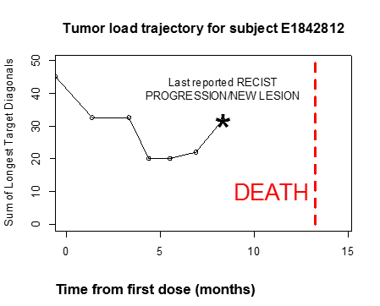
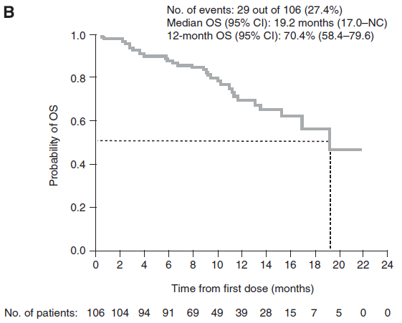
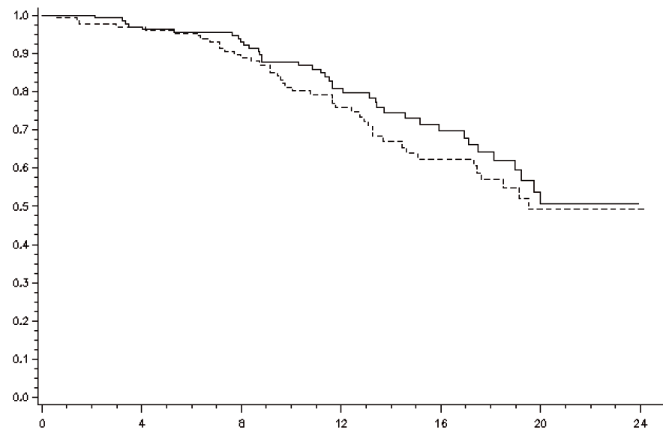
Clinical trial data
IPASS (Ph. III) and IFUM (Ph. IV) studies of 1st line gefitinib in NSCLC
IPASS (N = 430 subjects)
IFUM (N = 102 subjects)
Total number of measurements: n = 2302
Total number of measurements: n = 724
Gefitinib (N = 609) or Carboplatin+Paclitaxel (N = 608)
EGFR status known: N = 430
EGFR+ (N = 258) / EGFR– (N = 172)
Primary endpoint: PFS (Gefitinib > chemo)
Secondary endpoint: OS (Gefitinib = chemo)
Gefitinib (N = 106)
EGFR+ patients only
N = 102 with “clean” tumor data
KM estimates for OS (EGFR+ subpopulation)
KM estimate for OS (EGFR+ subpopulation)
Carboplatin/
Paclitaxel
Gefitinib
Probability of Survival
Probability of Survival
Time from first dose (months)
Time from first dose (months)
Mok et al. N Engl J Med. 2009 Sep 3;361(10):947-57
Douillard et al, Br J Cancer 2014 110:55-62
IPASS, NCT00322452
IFUM, NCT01203917

Slide 8
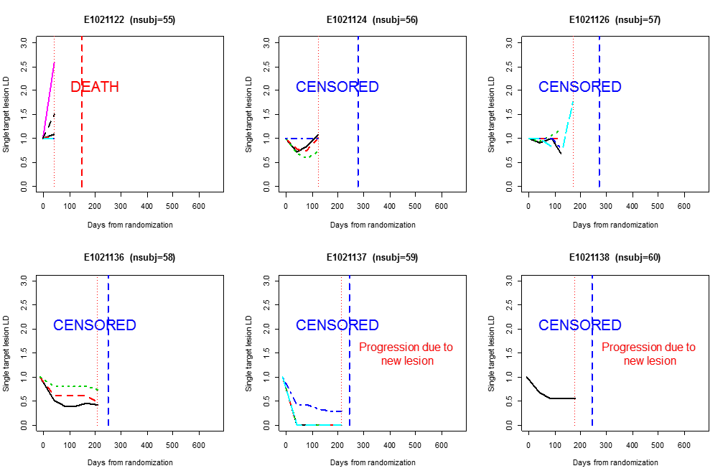
Clinical trial data: Examples of individual tumor profiles
IPASS, NCT00322452
6 randomly chosen
subjects with their
time profiles of
separate target lesions

Slide 9
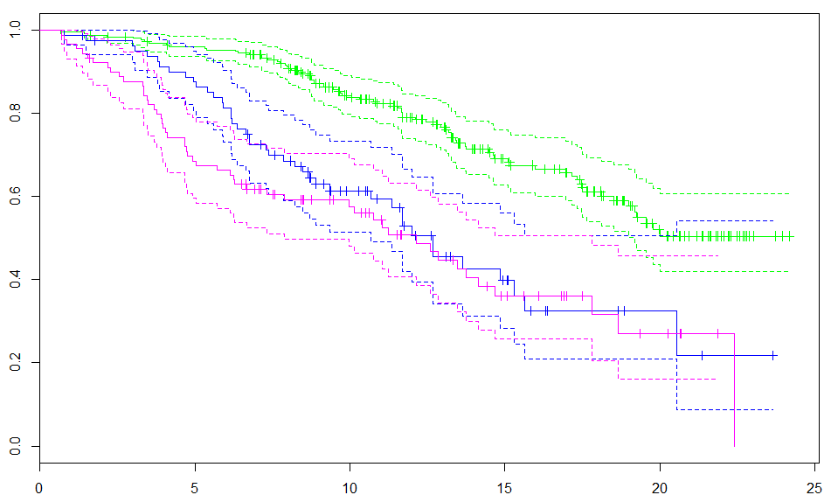
Joint model fitted on IPASS data: Summary
Combined
3-level
covariate:
 | Gefitinib | Chemo
EGFR+
EGFR–
Longitudinal model | Survival model
CAT*(1+T+T²) | ECOG_STATUS
A
C
B
LONGITUDINAL PROCESS
Value RSE(%) p-value
(Intercept) 71.7333 2.36 <0.0001
CAT/B 18.5058 25.24 0.0001
CAT/C 24.6942 16.58 <0.0001
MONTHS -8.6248 3.33 <0.0001
MONTHS^2 0.5584 3.21 <0.0001
CAT/B:MONTHS 0.9148 90.26 0.2679
CAT/C:MONTHS 10.9765 9.37 <0.0001
CAT/B:MONTHS^2 0.1414 58.56 0.0880
CAT/C:MONTHS^2 -0.7097 13.94 <0.0001
Value RSE(%) p-value
ECOG/Normal Activity -1.4038 20.28 <0.0001
ECOG/Restricted Activity -1.0701 23.32 <0.0001
Assoct(lag=8) 0.0127 11.02 <0.0001
Assoct.s(lag=8) 0.0450 22.67 <0.0001
CAT = A
Survival
CAT = C
CAT = B
EVENT PROCESS
Time lag of 8 months was significant in OS model
Months
IPASS, NCT00322452

Slide 10
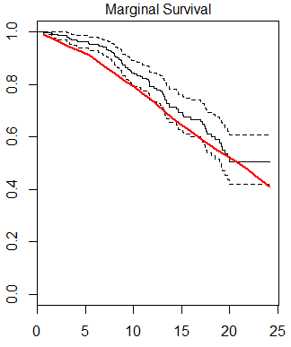
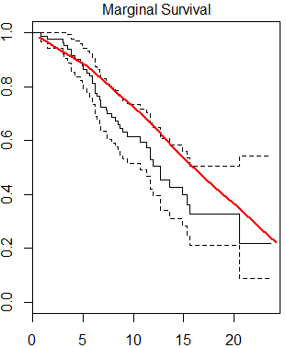
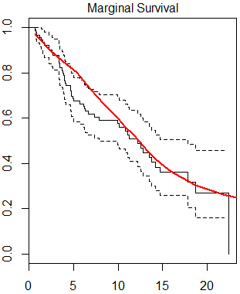
Posterior predictive checks for the joint model
Conditional survival estimates
CAT = A (258 subjects)
CAT = B (82 subjects)
CAT = C (90 subjects)
Survival
Months
IPASS, NCT00322452

Slide 11
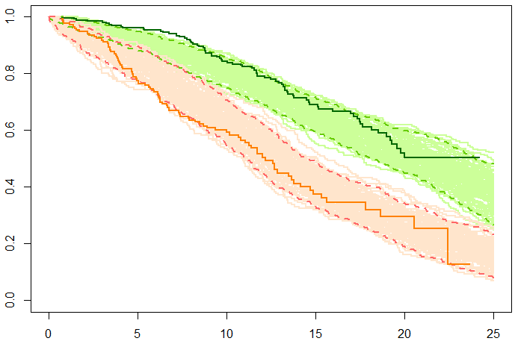
Internal model validation at study level
Clinical trial simulations
Kaplan-Meier survival estimates:
(EGFR+) mean
258 subjects
(EGFR+) 95% CI
(EGFR–) mean
(EGFR–) 95% CI
Probability (Survival)
172 subjects
Simulated trials: 100
Independent posterior draws for model parameters were used for each trial
Time from randomization (months)
Survival simulations for EGFR-stratified model population:
simulated survival outcomes are clearly separated based on a significant covariate
IPASS, NCT00322452

Slide 12
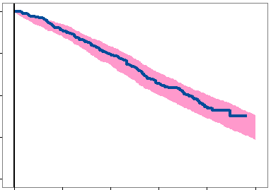
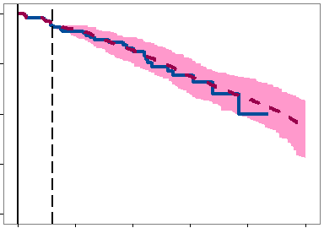
External model validation at study level
Clinical trial simulations
Joint model fitted on IPASS data
Model predicts IFUM survival using 3-month data cut-off
1.00
1.00
*
PHASE 3
PHASE 4
0.75
0.75
Probability of survival
Probability of survival
0.50
0.50
Observed
survival
Observed
survival
0.25
Model
simulations
(95% CI)
0.25
Model
simulations
(mean & 95% CI)
Cut-off
0.00
0.00
0
5
10
15
20
25
0
5
10
15
20
25
Time, months
Time, months
IFUM, NCT01203917
IPASS, NCT00322452

Slide 13
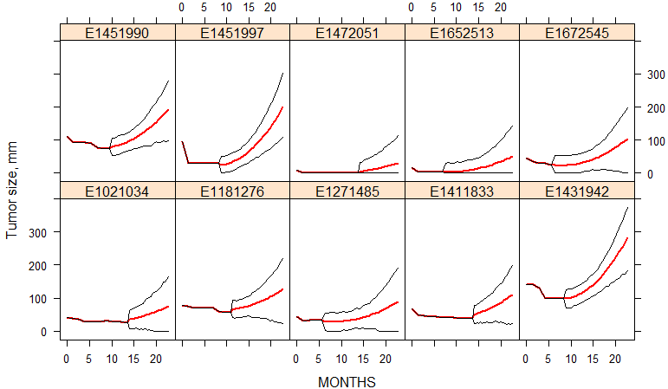
Tumor dynamics predictions for IFUM study
Individual simulations for the follow-up study
95% prediction band
Mean simulated value
IFUM, NCT01203917

Slide 14
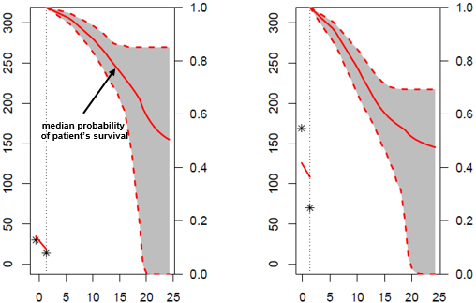
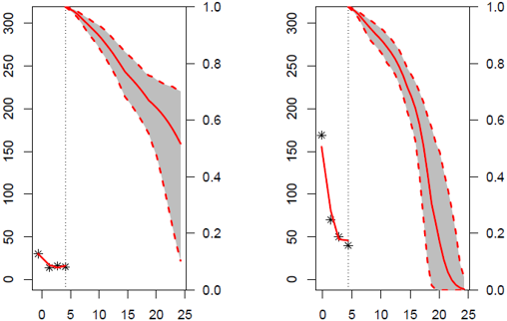
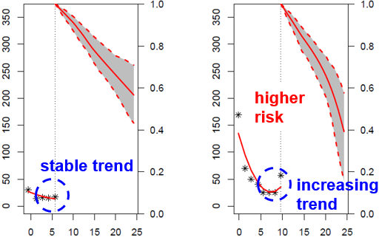
Dynamic subject-level prediction of survival in IPASS
2 mth
5 mth
10 mth
(predicted)
individual tumor
measurements
Subject 40
95% prediction band
for patient’s survival
Tumor size, mm
Probability (Survival)
IPASS, NCT00322452
Subject 113
Time from randomization (months)

Slide 15
Conclusions
Joint modeling of survival and tumor size provide a generalizable tool for
covariate search with respect to different types of endpoints, e.g. OS, PFS
efficient clinical trial simulations in various study populations
prospective forecasting of survival at study level
personalized predictions of survival in specific patient subgroups
Joint modeling framework: Next steps
Include non-linear models for continuous longitudinal markers
Test (semi)-mechanistic tumor size models - instead of empirical
Develop software to model with multiple time-dependent markers
Test event-like predictive markers, e.g., detection of a new lesion
Fit a joint model for OS & PFS – informative censoring comes into play

Slide 16

Thank you
QUESTIONS?
Dmitry.Onishchenko@msdecisions.ru

Slide 17
Backup slides

Slide 18
Independent (non-joint) modeling approach
(a) Tumor dynamics endpoint
Tumor Size (y [cm] )
Change over Time (t [days])
Placebo
Growth Rate [cm/day]
Drug
Effect
[cm/day]
=
–
dy/dt
=
r
–
[Eff_{dose(t)}]*y
Change in tumor size for each individual patient
Tumor Dynamics (Actual)
Tumor dynamic modeling
treatment effect
on longitudinal
tumor marker
Fractional tumor size
Treatment
Effect
Days after treatment

Slide 19
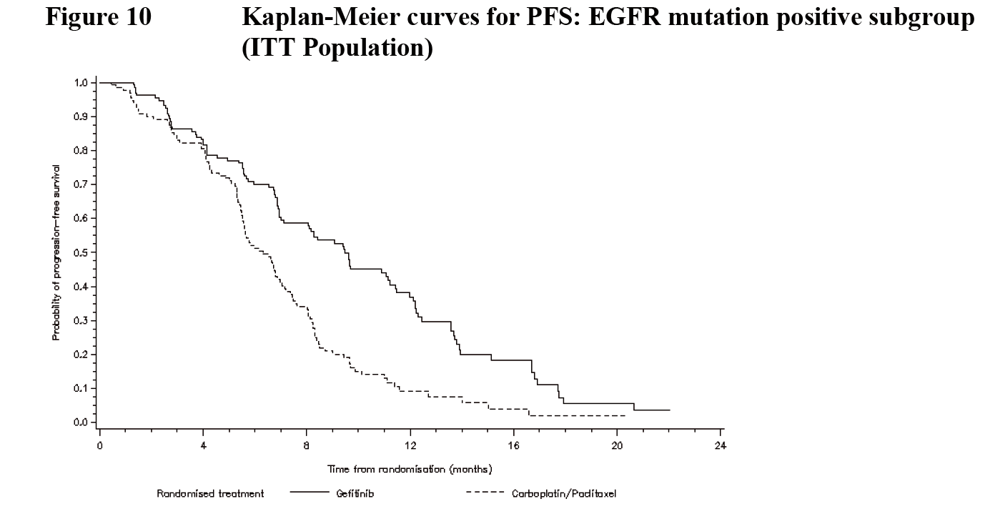
Independent (non-joint) modeling approach
(a) Dichotomous tumor dynamics endpoint (b) Study-level interpretation
Event modeling typically uses a minimally parametric approach (i.e., Cox Proportional Hazard), to protect against Type I error and maximize interpretability
Survival
[Days]
EGFR Mutation Status
Treatment
Arm
ECOG status
~
Progression Free Survival Hazard
~
a₁* EGFR
+
a₂*Trt Arm
+
a₃*ECOG
{a₁, a₂, a₃} are Cox coefficients linking each covariate measurement to Survival
Example: IPASS study, Iressa
K-M curves for PFS
EGFR-mutant subgroup of ITT population
Time to event (OS / PFS)
Probability of PFS
treatment effect
on Survival
Treatment
Effect
Time from randomization (months)

Slide 20
Clinical trial data: Examples of individual tumor profiles

